Slide 1
Upskilling employability workers
Summary of the impact of self-led 50+ training for frontline delivery staff on the Working Well Work and Health Programme (WHP) in Greater Manchester in 2021

Slide 2
About the training pilot
Work and Health Programme (WHP)

Slide 3
Context
The project piloted training for Key Workers (KWs) on the Work and Health Programme (WHP) in Greater Manchester (GM) on how to better support clients aged 50+
This cohort historically fares worse on employment support and less well on WHP
28% of 50+ clients aged on WHP for 15 months+ achieve Earnings Present (signifying a job start) vs 40% of under 50s
Analysis of WHP found age has a large effect on outcomes – only length of unemployment and confidence have a larger effect
Notes:
The ‘Upskilling employability workers’ project was a partnership between the Centre for Ageing Better, the Institute of Employability Professionals (IEP), APM/Ingeus and Greater Manchester Combined Authority
The project piloted training for Key Workers (KWs) on the Work and Health Programme (WHP) in Greater Manchester (GM) on how to better support clients aged 50+
WHP is a holistic employment support programme that targets GM residents who are long-term unemployed and/or have barriers to work such as health conditions and low skills levels. It provides 15 months out of work support and 6 months of in-work support.
Please see the Annual Evaluation Reports for further details on WHP
The 50+ cohort has historically fared worse on employment support and fares less well on WHP:
Monitoring data shows 28% of clients aged 50+ on GM’s WHP for 15 months+ have achieved Earnings Present (signifying a job start) versus 40% of those under 50 (DWP, Stat Xplore)
Econometric analysis of GM’s WHP in the 2021 Annual Evaluation Report tested individual variables while holding all other variables constant – and found that age is one of the variables with the largest effect on outcomes, with only length of unemployment and confidence in starting a job having a larger effect

Slide 4
Report focus
Evaluation of 50+ employability training for frontline staff delivering the Working Well Work and Health Programme (WHP)
A partnership between:
Centre for Ageing Better
Institute of Employability Professionals
APM/Ingeus
Greater Manchester Combined Authority
Prepared by SQW, an independent social development research consultancy
Notes:
The ‘Upskilling employability workers’ project was a partnership between the Centre for Ageing Better, the Institute of Employability Professionals (IEP), APM/Ingeus and Greater Manchester Combined Authority
The project piloted training for Key Workers (KWs) on the Work and Health Programme (WHP) in Greater Manchester (GM) on how to better support clients aged 50+
WHP is a holistic employment support programme that targets GM residents who are long-term unemployed and/or have barriers to work such as health conditions and low skills levels. It provides 15 months out of work support and 6 months of in-work support.
Please see the Annual Evaluation Reports for further details on WHP
The 50+ cohort has historically fared worse on employment support and fares less well on WHP:
Monitoring data shows 28% of clients aged 50+ on GM’s WHP for 15 months+ have achieved Earnings Present (signifying a job start) versus 40% of those under 50 (DWP, Stat Xplore)
Econometric analysis of GM’s WHP in the 2021 Annual Evaluation Report tested individual variables while holding all other variables constant – and found that age is one of the variables with the largest effect on outcomes, with only length of unemployment and confidence in starting a job having a larger effect

Slide 5
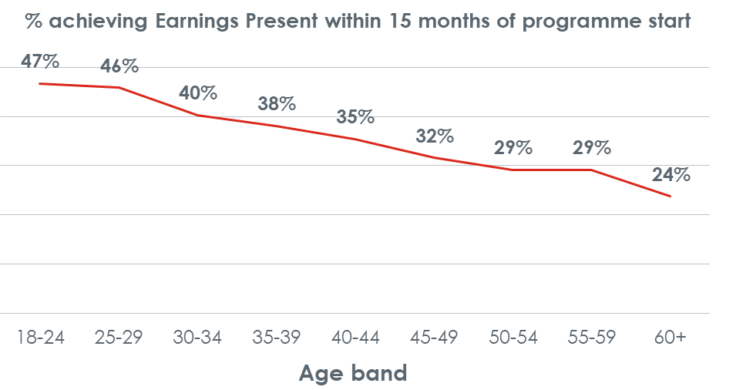
About the Working Well Work and Health Programme (WHP)
Designed for long-term unemployed people in Greater Manchester
Addresses barriers to employability e.g. health conditions, low skills
Delivers 15 months out-of-work support and six months of in-work support
Under 50s on WHP supported into work (Earnings Present) = 40%
50+ on WHP: Earnings Present = 28%
Employability challenges for 50+
DWP, Stat Xplore. Data covers starters up to May 2020 who completed WHP
Notes:
The training:
Was developed in collaboration between the Centre for Ageing Better, the Institute of Employability Professionals (IEP) and APM/Ingeus based on research by the Centre for Ageing Better and input from WHP Key Workers
Consisted of four online modules which were self-completed by Key Workers
Was intended to lead to changes in the practice and attitudes of Key Workers – and so improve outcomes for 50+ clients as a result
Was piloted by Ingeus Key Workers in Bolton, Oldham, Stockport and Tameside (the intervention group), with Key Workers in Bury, Rochdale and Wigan (the non-intervention group) acting as a control group (note that GM WHP also covers Manchester, Salford and Trafford but the programme is delivered by a different provider in those local authorities)
Was completed by Key Workers in July 2021

Slide 6
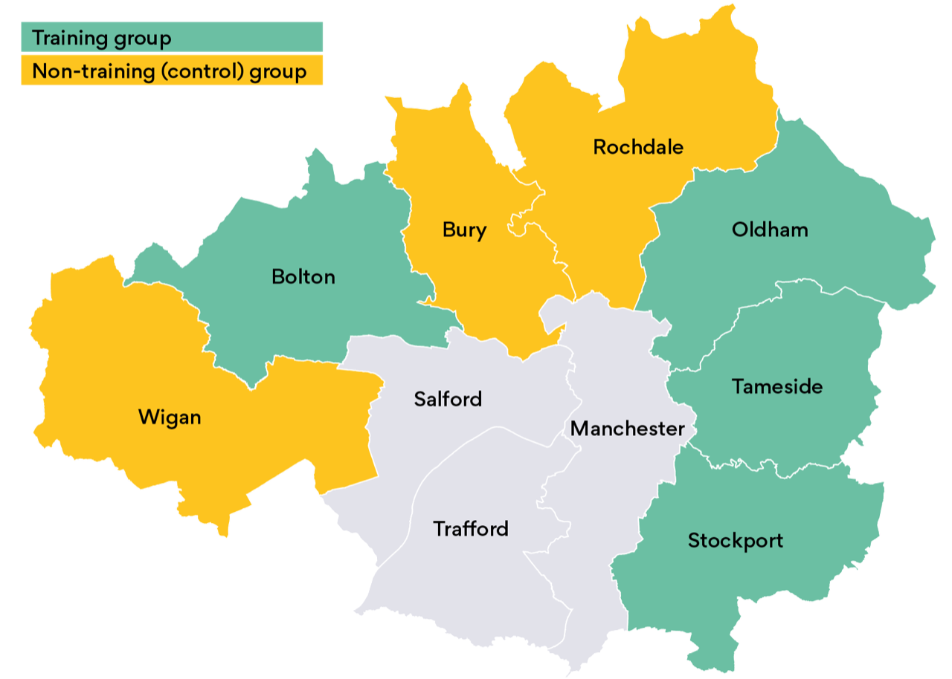
Training content and cohort
Training developed by the Centre for Ageing Better, the Institute of Employability Professionals (IEP) and APM/Ingeus
Based on research by the Centre for Ageing Better and input from WHP Key Workers (KWs)
Four online modules self-completed by Ingeus KWs
Intended to lead to changes in practice and attitudes – and so improve outcomes for 50+ clients as a result
Study geography and groups
Note that WHP also covers Manchester, Salford and Trafford, but delivered by a different provider

Slide 7
Evaluation methods and model
To answer whether the evaluation led to changes to KW practice/attitudes and client outcomes, SQW used:
Baseline and follow-up surveys to capture changes and ‘distance travelled’ in the short-term for KWs and medium-term for clients
Focus groups with KWs and clients to explore changes to practice over the medium-term
Analysis of WHP data including ‘hard outcomes’ (starting/retaining jobs, reaching an earnings threshold) and soft outcomes (e.g. health ranking as a barrier to work)
The Kirkpatrick Model for evaluating training programmes was used in the design of research tools, which comprises four levels:
Reaction to training: satisfaction, suggestions for refinements, intentions for implementation
Learning: what has or has not been learnt, including ‘distance travelled’
Behaviour: how learning is put into practice
Results: impact of changes in behaviour
Notes:
SQW evaluated the training, building on their existing evaluation of the Work and Health Programme in Greater Manchester
To answer whether the evaluation led to changes to KW practice and attitudes, and ultimately client outcomes, the following methods were used:
Surveys of KWs and clients – using baseline and follow-up surveys to capture changes and distance travelled in the short-term for KWs and medium-term for clients
Fieldwork – focus groups with KWs and clients to explore changes to practice in more depth and over the medium-term
WHP monitoring data – analysis of routine data captured by WHP which includes ‘hard outcomes’ (such as job starts, sustainment and reaching an earnings threshold) and soft outcomes (such as ranking of health as a barrier to work)
The Kirkpatrick Model was used in the design of research tools. It is a model for evaluating training programmes, consisting of four levels:
Reaction to training – including satisfaction, suggestions for refinements, intentions for implementation
Learning – what has or has not been learnt, including measurement of ‘distance travelled’
Behaviour – how learning been put into practice
Results – the impact of any changes in behaviour

Slide 8
Research approach
Key Workers

Slide 9
KW survey group sizes and age
1. Baseline for KWs receiving training: 22 responses (out of 26 - some non-respondents subsequently left)
Follow-up for KWs receiving training: 20 responses (= attrition of 2) four to eight weeks after training
Baseline for KWs not receiving training: 13 responses in July 2021
Non-training group more likely to be 40-49
Training group ages more broadly spread
SQW conducted three KW surveys
Age | 1. Baseline survey (w/ training) |  | 2. Follow-up survey (w/ training) |  | 3. Baseline survey (no training)
 | Count | % of respondents | Count | % of respondents | Count | % of respondents
20-29 | 1 | 5% | 1 | 5% | 1 | 8%
30-39 | 7 | 32% | 7 | 35% | 1 | 8%
40-49 | 6 | 27% | 6 | 30% | 9 | 69%
50-59 | 7 | 32% | 5 | 25% | 2 | 15%
60+ | 1 | 5% | 1 | 5% | - | -
Notes:
In total there were three surveys of Key Workers (KWs):
Baseline survey for KWs receiving training: 22 responses (out of 26 - some non-respondents subsequently left)
Baseline survey for KWs not receiving training: 13 responses
Follow-up survey for KWs receiving training: 20 responses (= attrition of 2)
The baseline surveys were run at the start of July 2021 immediately prior to the training. The follow-up survey was answered in August and September around 4-8 weeks following completion of the training
KWs not receiving the training were not surveyed twice because there was no intervention that was expected to have an effect on responses
Response rates by KW age and local authority are shown in the tables. Age was collected for context and so that its significance can be tested. The surveys found that KWs in the non-treatment area are far more likely to be 40-49, while the treatment area has a broader spread of ages

Slide 10
Survey questions for KWs
KWs were asked about the barriers to work clients face and how well equipped they felt to support the 50+ cohort
KWs receiving training were asked about training need, expectations (baseline) and learning/changes to practice (follow-up)
Questions were repeated to measure ‘distance travelled’ from baseline to follow-up
Surveying KWs about ‘older clients’ drew attention to age as an employability factor, which presented a risk that KWs would give the ‘right’ answers rather than their actual beliefs
Notes:
About the KW surveys
The surveys covered:
Questions to gauge KW views on the barriers clients face to work, how well equipped KW’s felt in supporting older clients, and how well the Work and Health Programme is designed to meet the needs of older clients
These questions were asked of KWs in the treatment and non-treatment areas to capture any differences between the areas
The same questions were repeated in the baseline and follow-up survey to capture changes including ‘distance travelled’
KWs receiving training were asked in the baseline for their views on why training may be needed, and what they hoped to get out of it. In the follow-up they were asked for their feedback on the training, what they had learnt, and what changes they had implemented to their practice.
Note that a limitation of surveying KWs about ‘older customers’ means drawing attention to age as a factor and there is a risk that KWs attempted to give the ‘correct’ answer rather than expressing their actual beliefs

Slide 11
KW focus groups: composition
Six groups in Dec 21/Jan 22
Group 1-4: KWs from the intervention areas
Group 5: KWs who could not attend
Group 6: Team managers from three intervention areas
Attended by 18 out of 19 KWs who had completed the training
Facilitated by SQW, an independent social development research consultancy
Facilitator tested the medium-term training impact, covering:
Extent of retained knowledge and changes to practice
Improved understanding and awareness/mindfulness
Impact on clients (KW relationship, engagement and outcomes
Other reflections on the training
Focus groups drew out learning and encouraged deeper reflection than surveys
Notes:
After the follow-up survey in Aug/Sep-2021 a series of focus groups were held with Key Workers in Dec-21/Jan-22. In total, there were six focus groups:
One with groups of KWs from each of the four intervention areas plus an additional focus group for those who could not attend – these were attended by 18 out of 19 KWs who had completed the training and were still in the role
One with team managers in three of the four intervention areas
The focus groups enabled SQW to test the medium-term impact of the training, including:
To what extent has knowledge been retained?
To what extent have changes to practice been implemented?
Has improved understanding and awareness/mindfulness of client needs led to changes in practice not anticipated at the time of answering the survey?
What impact has this had on clients (KW relationship, engagement and outcomes)
Any further reflections based on time to reflect on the training and experience of putting learning into practice
More probing on reception to the training and conditions it was completed under
As highlighted later, there had been little discussion of the training between KWs, and therefore having the opportunity for discussion via the focus groups appeared to be a formative addition to the training, and helped to draw out learning and encourage reflection to a greater extent than the surveys

Slide 12
Research findings
Key Workers

Slide 13
Pre-training KW survey responses
To what extent do you agree with these statements? (1=strongly disagree and 10=strongly agree)*
Statement | 4 | 5 | 6 | 7 | 8 | 9 | 10 | Number of responses | Average scores
I’m looking forward to training | 0 | 1 | 2 | 1 | 4 | 4 | 5 | 17 | 8.4
I understand the need for training | 0 | 3 | 1 | 2 | 4 | 3 | 4 | 17 | 7.9
Training will make a real difference to working practices | 1 | 2 | 2 | 1 | 4 | 2 | 5 | 17 | 7.8
Training is required | 1 | 2 | 2 | 1 | 5 | 1 | 5 | 17 | 7.8
Most KWs were in strong to mild agreement that they were looking forward to the training, saw the need for it and expected it would make a difference to their practice. A small number neither agreed or disagreed, or mildly disagreed with the statements. One manager noted that KWs did not understand the rationale for focusing on 50+ before the training.
*5 KWs in the treatment group completed the wrong baseline survey hence the lower number of responses to baseline questions about training
Notes:
what extent do you agree with the following statements? (1=strongly disagree and 10=strongly agree)*
strong to mild agreement from the majority of KWs on the need for training, that they were looking forward to it and expectations that it would make a difference to their practice. The highest average score was for “I am looking forward to the training.” A small number gave a score indicating they neither agreed or disagreed, or mildly disagreed with the statements – one manager said that prior to the training some KWs did not understand the rationale for a specific focus on the over 50s cohort.

Slide 14
Pre-training KW survey responses
What is the main thing you hope to get out of the training?
Outcomes sought from training | Count | % of KWs
Improved knowledge of approaches to supporting older customers | 11 | 65%
knowledge of older people's needs | 6 | 35%
Improved skills in supporting customers | 2 | 12%
Share experiences with other KWs | 1 | 6%
Responses to this question show KWs were most likely to be hoping to learn new approaches to supporting older clients or a better understanding of needs – showing an appetite for improving their practice
Notes:
what extent do you agree with the following statements? (1=strongly disagree and 10=strongly agree)*
strong to mild agreement from the majority of KWs on the need for training, that they were looking forward to it and expectations that it would make a difference to their practice. The highest average score was for “I am looking forward to the training.” A small number gave a score indicating they neither agreed or disagreed, or mildly disagreed with the statements – one manager said that prior to the training some KWs did not understand the rationale for a specific focus on the over 50s cohort.

Slide 15
KW voices: what are your pre-training expectations?
“
“
Some customers don’t feel they can or want to work. Age can be a factor of this mindset. I’d like to gain knowledge that helps our clients with this mindset.”
Greater depth of understanding of issues facing older job applicants and practical advice on supporting them into employment.”
“
“
Looking at ways we can offer extra support especially to those who are coming of retirement age.”
Better understanding and more skills to work with older people to support them with moving into employment.”
“
To widen my knowledge on the barriers older participants face when moving into the workplace.”

Slide 16
Post-training KW survey responses
To what extent do you agree with these statements? (1=strongly disagree and 10=strongly agree)*
Statement | 5 | 6 | 7 | 8 | 9 | 10 | Number of responses | Average scores
I understand why I received the training | 1 | 0 | 4 | 6 | 7 | 2 | 20 | 8.2
I found the training useful | 1 | 1 | 3 | 8 | 5 | 2 | 20 | 8.1
I found the training interesting | 1 | 1 | 4 | 8 | 5 | 1 | 20 | 7.9
The training materials made sense | 1 | 1 | 4 | 9 | 4 | 1 | 20 | 7.9
The training materials were easy to use | 1 | 0 | 6 | 6 | 5 | 1 | 20 | 7.7
I would recommend training to a colleague | 3 | 2 | 6 | 3 | 4 | 2 | 20 | 7.5
The training has made a real difference to the way I work with older customers | 7 | 0 | 7 | 3 | 2 | 1 | 20 | 6.8
The vast majority agreed that the training was useful, interesting, made sense and easy to use. Most agreed they would recommend the training to a colleague. But the perceived impact on practice was more limited, as 7 out of 20 KWs neither agreed or disagreed with the statement.
Answers reflected limited impact or limited time/opportunity to implement changes for these KWs, or lack of clarity about what, if anything, to do differently.
The findings overall were positive but suggested scope for greater impact on practice.
Notes:
The table above on how the training was received is ordered by the average score, and shows:
Strong understanding of why the training was provided
The vast majority agreed that the training was useful, interesting, made sense and easy to use, with most agreeing they would recommend the training to a colleague as a result – average scores of 8.1 to 7.5 show moderate agreement with these statementsHowever the perceived impact on practice was more limited, with an average score of 6.8 due to 7 out of 20 KWs neither agreeing or disagreeing with the statement – looking at responses these 7 gave to the baseline we can see the average score to ‘feeling well equipped’ was 5.9 out of 10 so there was scope for improvement, meaning these answers will reflect limited impact or limited time/opportunity to implement changes for these KWs, or lack of clarity about what if anything to do differently
Overall, these findings were positive but suggested scope for greater impact on practice. The fieldwork provided further opportunity to test these findings, and the findings from the focus groups are presented on the next slide…

Slide 17
KW focus group feedback
Strengths – KWs liked
Online format and platform
Interactivity to sustain engagement
Quizzes for testing knowledge
Added value of statistics on:
Statistics on barriers faced by 50+ cohort
Rationale underlying guidance provided
Areas for future consideration
Some KWs preferred self-directed online leaning at their own pace
Others (slightly more) preferred face-to-face training and group sessions
KWs felt there was more focus on challenges faced by the 50+ cohort than practical solutions to addressing the challenges
Notes:
The focus groups with KWs also found:
The consensus was that the format and platform worked well for the training – and some specifically praised the interactivity for maintaining engagement and quizzes for testing knowledge Learning preferences differed, however, with some KWs stating a preference for independent and online training that “could be completed at my own pace”; and others preferring face-to-face training and group sessions – views were mixed but slightly skewed towards the latter
The content was well received and some KWs highlighted the value added by:
Inclusion of statistics that illustrate the nature of the challenges faced by the 50+ cohort
Inclusion of the rationale/explanation behind the guidance provided
That said, a common comment was that there was more information about the problems faced by the 50+ cohort rather than practical solutions
Possible improvements to the training are returned to later, following consideration of the impacts of the training on practice and clients

Slide 18
Contextual factors to consider
Factor
KWs and managers felt training was rushed due to workload, diary clashes, remote working and summer leave
Focus groups did provide an opportunity for group discussion at a later date​
Variety of age, length of role experience and pre-existing perceptions of age as a barrier
Training was considered novel
Ages of KW caseloads differ, so some had limited opportunity to put learning into practice
Consequence
Insufficient time for group reflection on the training to reinforce its impact
Factors influenced level of pre-existing knowledge and response to training
KWs had no previous issue-specific training
KWs with few 50+ clients have limited opportunity to implement training. Some reported that their 50+ clients were not disadvantaged
Notes:
The fieldwork identified the following contextual factors, which are important to consider when interpreting the findings, and which inform observations and recommendations made later:
KWs and managers felt that completion of the training was rushed and as a result there was not sufficient opportunity to build in time for KWs to reflect on the training together as a group which could have augmented and reinforced learning from the training – this was due to issues fitting the training into calendars at short notice, levels of busyness, remote working and summer holidays
– although the focus groups did provide an opportunity for group discussion at a later date
KWs who completed the training were varied in their age, length of experience in their role and pre-existing perceptions of age as a barrier, and these factors appeared to be important to the level of pre-existing knowledge and how the training was received
The training was considered novel, with KWs reporting that they had not completed any issue- specific only training before – generally knowledge development is on-the-job and via discussions in case conferences and team meetings
The ages of KWs’ caseloads vary widely, with some having very limited numbers of 50+ clients and therefore limited opportunity to put the learning into practice compared to KWs with a greater proportion of 50+ clients (similarly, some reported the 50+ clients they have were not especially disadvantaged, so again there was less opportunity to implement learning)

Slide 19
Knowledge gained
Key Workers

Slide 20
KW post-training survey feedback
The follow-up survey asked for KW’s top three learnings from the training
Half of KWs did not identify new learning or did not want to answer
Those who identified learning noted a better understanding of the 50+ cohort’s health and care needs and how to support them
In practice, a better understanding of needs is likely to result in more tailored and effective support
Lessons learned from training | Count | % of KWs
Don't know / N/A | 10 | 50%
Better understanding needs of older customers | 9 | 45%
How to provide appropriate support | 7 | 35%
Older customers can have lower confidence | 2 | 10%
Built on existing knowledge | 1 | 5%
How older customers feel when changing work goals | 1 | 5%
Age discrimination | 1 | 5%
How older customers are made to feel | 1 | 5%
Notes:
In the follow-up survey KWs were asked what the top three things they learnt from the training – the table shows the responses:
Half of KWs either responded ‘Don’t know’ or ‘N/A’ – so many could not point to any new learning or did not want to provide an answer
– of these six did neither agreed nor disagreed the training had an impact on their practice, but four agreed it had
Of those who did identify learning the most frequent response was gaining a better understanding of the needs of older clients around health and caring for example, followed by better understanding how to provide more appropriate support – noting that in practice better understanding of needs is also likely to facilitate more tailored and effective support

Slide 21
KW voices: lessons learned
“
“
Very informative. It gave me more in-depth understanding and knowledge of the barriers older participants may face to work. I learned some things I didn’t know previously, but also confirmed my knowledge on things I did know.”
Very informative. It gave me more in-depth understanding and knowledge around background to the barriers older participants face. I learnt things I didn’t know, but also confirmed my knowledge on things I did.”
“
It was based on common sense. If you work in employability, you do know these things. It was a nice reminder.”
“
For me it was a refresher of how to do deal with those of an older age. Because I am older, I don’t always like to consider age as an explicit barrier.”

Slide 22
KW post-training focus group feedback
Value of focus group feedback
The focus groups provided opportunities to:
Capture reflections on lessons learned five to six months after training
Test knowledge retention
KWs reflected more deeply than when the survey issued after training completion
Findings around lessons learned were noticeably more positive than the survey suggested
Feedback
KWs were positive about training impact
KWs had mixed views on the impact of training on their level of knowledge:
Most felt it confirmed their knowledge and practice
Less experienced KWs said it offered new or deeper knowledge
Notes:
The focus groups provided the opportunity to capture reflections on lessons learnt 5-6 months after the training, allowing the retention of knowledge to be tested. The findings around lessons learnt were noticeably more positive than the survey suggested, likely due to:
The focus group discussions encouraged reflection and drew out more examples of learning, so those who had initially suggested a more limited impact were more likely to recognise what they had learnt, especially in response to others
KWs were possibly less reflective in their responses to the online survey, which was completed independently, shortly after the post- training
In the focus groups all KWs were positive about the training’s impact, though the level of impact on knowledge differed, falling into two broad camps:
For a large group of KWs the training confirmed existing knowledge/practice (explaining why the survey found half of KWs reporting they had not learnt anything new) but having existing knowledge affirmed or refreshed was nonetheless valued – more experienced KWs tended to have this view
For a smaller group of KWs the training provided new or greater depth of knowledge – less experienced KWs tended to have this view
The knowledge gained or affirmed related to:
The specific barriers that older clients are more likely face in finding employment (low confidence due to age was mentioned frequently)
Identifying resources that can be used to support older clients (such as the No Desire To Retire website)
How employment support programmes can fail to effectively support older clients and common prejudices/biases
How employers can discriminate based on age, and approaches to counter this

Slide 23
KW post-training focus group feedback: learnings
KWs reported knowledge gained or confirmed related to:
Barriers older clients face in finding employment (e.g. low confidence due to age)
Identifying resources to support older clients (such as the No Desire To Retire website)
How employment support programmes can fail to support older clients effectively
Common prejudices/biases
Employer age discrimination and approaches to counter it
Notes:
The focus groups provided the opportunity to capture reflections on lessons learnt 5-6 months after the training, allowing the retention of knowledge to be tested. The findings around lessons learnt were noticeably more positive than the survey suggested, likely due to:
The focus group discussions encouraged reflection and drew out more examples of learning, so those who had initially suggested a more limited impact were more likely to recognise what they had learnt, especially in response to others
KWs were possibly less reflective in their responses to the online survey, which was completed independently, shortly after the post- training
In the focus groups all KWs were positive about the training’s impact, though the level of impact on knowledge differed, falling into two broad camps:
For a large group of KWs the training confirmed existing knowledge/practice (explaining why the survey found half of KWs reporting they had not learnt anything new) but having existing knowledge affirmed or refreshed was nonetheless valued – more experienced KWs tended to have this view
For a smaller group of KWs the training provided new or greater depth of knowledge – less experienced KWs tended to have this view
The knowledge gained or affirmed related to:
The specific barriers that older clients are more likely face in finding employment (low confidence due to age was mentioned frequently)
Identifying resources that can be used to support older clients (such as the No Desire To Retire website)
How employment support programmes can fail to effectively support older clients and common prejudices/biases
How employers can discriminate based on age, and approaches to counter this

Slide 24
Perceptions of barriers to work
Key Workers

Slide 25
KW perceptions of employability barriers
Barrier | Baseline (w/ training |  | Follow up (w/ training
 | Count | % of KWs | Count | % of KWs
Age | 12 | 60% | 16 | 80%
Limited skills, experience and/or qualifications | 9 | 45% | 15 | 75%
Health | 14 | 70% | 14 | 70%
IT skills/access | 15 | 75% | 12 | 60%
Low confidence | 13 | 65% | 9 | 45%
Caring responsibilities | 3 | 15% | 7 | 35%
Nature of available jobs | - | - | 4 | 20%
Job searching - access, skills, CV | - | - | 2 | 10%
Financial responsibilities | 1 | 5% | 1 | 5%
Unable to access support | - | - | 1 | 5%
Motivation | 5 | 25% | - | -
Knowledge of job market/transferable skills | 3 | 15% | - | -
Willingness to train/retrain or switch sector | 3 | 15% | - | -
Access to job market | 3 | 15% | - | -
Job searching knowledge/skills | 1 | 5% | - | -
Willingness to accept lower wages | 12 | 5% | - | -
KWs listed up to five barriers to work older clients are more likely to face than younger clients
Age was more frequently identified barrier after training
Limited skills, experience and/or qualifications were more commonly identified after training
Low confidence / motivation was seen as less important after training

Slide 26
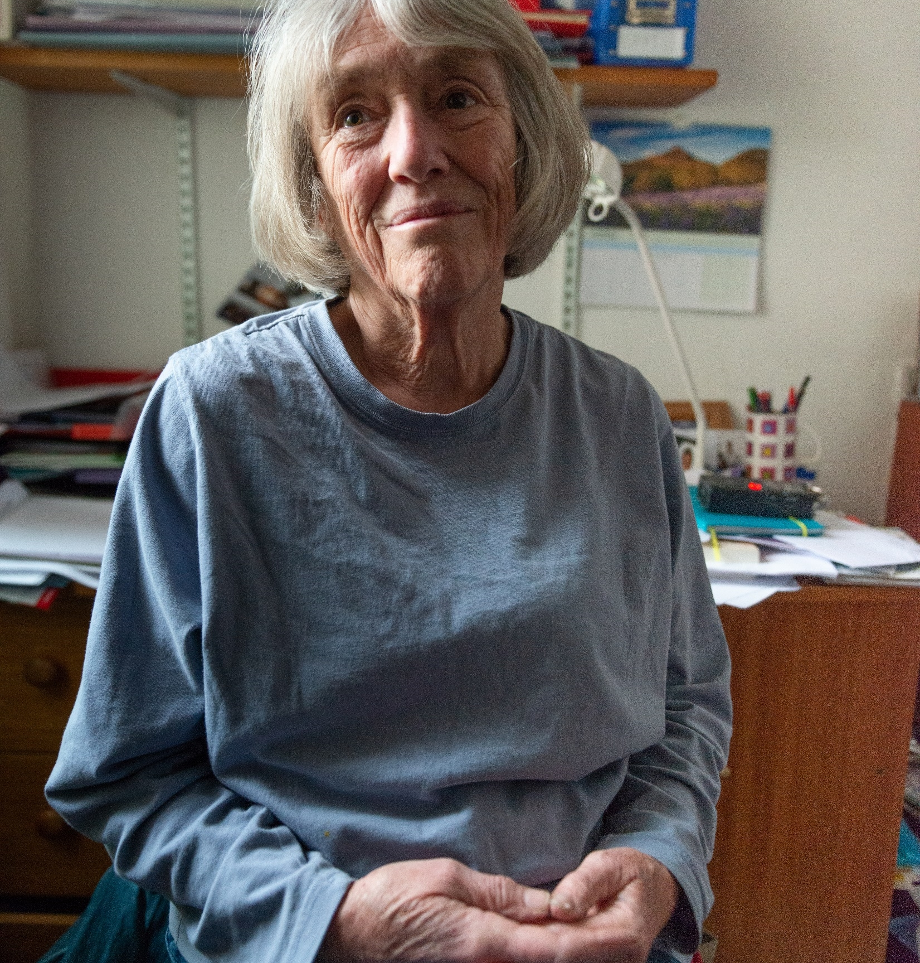
KW perceptions of older clients
KWs rated their agreement with statements about support needs and prejudices older people face compared with younger people.
Comparing baseline and follow-up responses suggests:
Improvements in perceptions about 50+ motivation, attitude and capabilities
Increased recognition of age discrimination by employers, barriers such as care, and the need to consider other sectors
Notes:
The KWs agreed with statements about older clients versus younger clients on topics relating to the training – the statements ask about relative support needs and some prejudices that older clients can face
Comparing the baseline and follow-up responses, the following findings stand out:
The biggest increases and decreases suggest improvements in perceptions about motivation, attitude and capabilities of older clients – in line with the previous slide
There are small increases in recognition of age discrimination by employers, specific barriers such as care, and the need to consider other sectors
In both surveys on average KWs neither agreed or disagreed that older clients are less likely to find work through employment support – despite this being true as set out in the training and as monitoring data on WHP in Greater Manchester shows

Slide 27
Impact on practice
Key Workers

Slide 28
Impact on KW practice
Did the training make you think you need to change your practice with older clients?
Most KWs thought they needed to change their practice, but mostly “a little” rather than “a lot”. A sizeable proportion reported no need to change to their practice
Those who said ‘No’ were more likely to feel better equipped in the baseline (average score of 7.4) than those who said ‘Yes, a little’ (6.6) and ‘Yes, a lot’ (5.0)
Response | Count | % of KWs
No | 8 | 40%
Yes, a little | 10 | 50%
Yes, a lot | 2 | 10%
Training was more impactful for those who felt less equipped to support older clients beforehand
Notes:
The survey asked KWs whether they thought they needed to change their practice as a result of the training, which found:
Most KWs thought they did need to change their practice, but mostly “a little” rather than “a lot”
But a sizeable proportion reported no need to change to their practice
These responses were checked against responses to the baseline survey question: ‘How well equipped do you feel to support older clients?’ which found:
Those who said ‘No’ were more likely to feel better equipped in the baseline (average score of 7.4) than those that said ‘Yes, a little’ (6.6) and ‘Yes, a lot’ (5.0)
So the training has been more impactful for those who felt less equipped to support older clients beforehand

Slide 29
Changes in practice (survey)
KWs were asked how they have changed their practice since the training
45% provided no response
Common responses related to greater awareness, mindfulness and/or understanding of older clients
Other comments were on changes to practice in specific areas of need
One KW said they needed ‘refresher’ training
How have you changed your practice as a result of the training?
Response | Count | % of KWs
No response | 9 | 45%
More mindful/aware/understanding of needs | 9 | 45%
Better equipped around age discrimination | 1 | 5%
Focus on motivation | 1 | 5%
More creative approach | 1 | 5%
Need more training | 1 | 5%
Notes:
KWs were subsequently asked an open question on how they have changed their practice as a result of the training
45% provided no response, which includes all those who responded ‘No’ to the previous question and one who said ‘Yes, a little’
The most common responses related to being generally more aware, mindful and/or understanding of older clients
(45% of KWs) with comments about being more ‘open minded’ and ‘digging deeper’
The rest of the comments on changes to practice focused on specific areas of need
Note that one KW used the space to say they needed ‘refresher’ training

Slide 30
Changes in practice (focus groups) 1
Focus groups uncovered more post-training impacts on practice than surveys, related to:
Higher confidence and assuredness about existing practices
More explicit focus on existing good practices
KWs saw training as a ‘refresher’ rather than a call to adopt entirely new practices
KWs more confident to raise and address issues e.g. changes in labour markets, IT skills and the benefits of working
Training reinforced the need for:
A personalised service approach
Empathy, understanding and consideration
Fewer assumptions about clients
More focus on personal employability barriers rather than work and skills
More emphasis on building confidence, self-worth, and motivation
Better communication using the appropriate language and terminology
Notes:
The KWs agreed with statements about older clients versus younger clients on topics relating to the training – the statements ask about relative support needs and some prejudices that older clients can face
Comparing the baseline and follow-up responses, the following findings stand out:
The biggest increases and decreases suggest improvements in perceptions about motivation, attitude and capabilities of older clients – in line with the previous slide
There are small increases in recognition of age discrimination by employers, specific barriers such as care, and the need to consider other sectors
In both surveys on average KWs neither agreed or disagreed that older clients are less likely to find work through employment support – despite this being true as set out in the training and as monitoring data on WHP in Greater Manchester shows

Slide 31
Changes in practice (focus groups) 2
Younger KWs used their increased understanding to allay nervousness and challenge “I’m too old” attitudes
Higher confidence and assuredness about existing practices
More focus on existing good practices
Training reminded some to signpost clients to the ‘No Desire to Retire’ website
Better awareness of employer ageism among a few KWs, who were
More confident engaging employers
More focused on targeted job search and employers who actively employ 50+
Impacts were generally greater for younger, less experienced KWs with fewer older clients on their caseload
Notes:
Younger KWs highlighted the disadvantage they faced from the lack of shared understanding and/or shared connection, and better understanding the needs/situations of older clients, was allaying nervousness and helping them to better challenge the “I’m too old” refrain from clients
Better awareness of ageism amongst employers, and how to deal with it:
A few KWs mentioned greater confidence engaging employers directly
A few KWs mentioned refreshed thinking on how to engage with employers and doing more targeted job searching – including focusing on employers who actively employ older people
Many KWs mentioned focusing on strengths – points highlighted included greater experience, transferable skills, maturity, more existing and nuanced knowledge, need for less support/management time, fewer mistakes, greater reliability and higher productivity
One KW mentioned that the training had reminded them of the ‘No Desire to Retire’ website, and they had made signposts since
The listed impacts were generally of a greater magnitude for KWs who were younger, less experienced and/or had fewer older clients on their caseload – the impact on confidence especially pronounced for these KWs

Slide 32
KW voices: changes in practice
“
“
To be more mindful of the potential barriers older clients face and to dig a bit deeper to try and find out any underlying reasons for how they feel.”
Brought home for me why it is important to be a lot more empathetic with older people. These people can be quite deflated and get knocked back really quickly. They think their age is a real barrier, and I don’t think it is.”
“
Previously I may have had bias to think that older clients could be written off.”
“
Be more open minded and consider more options working with over 50s.”
“
I think the training makes you understand the background to the negativity clients bring to their job application process.”
.”

Slide 33
KW voices: changes in practice
“
“
I learnt how to better communicate with older people. More on their level, actively listening to their experience and drawing out all the transferable skills. It built my confidence up.”
Before the training, I wouldn’t dig as deep into older peoples career history. I really examine this now and look into the history and draw out every transferable skill I can. Then try and sell this to employers.”
“
I think the training makes you understand the background to the negativity clients bring to their job application process.”
“
I have rarely been in those situations with older people before, so the training is useful for building my confidence and preparing for when they do come around.”

Slide 34
Impact on clients
Key Workers

Slide 35
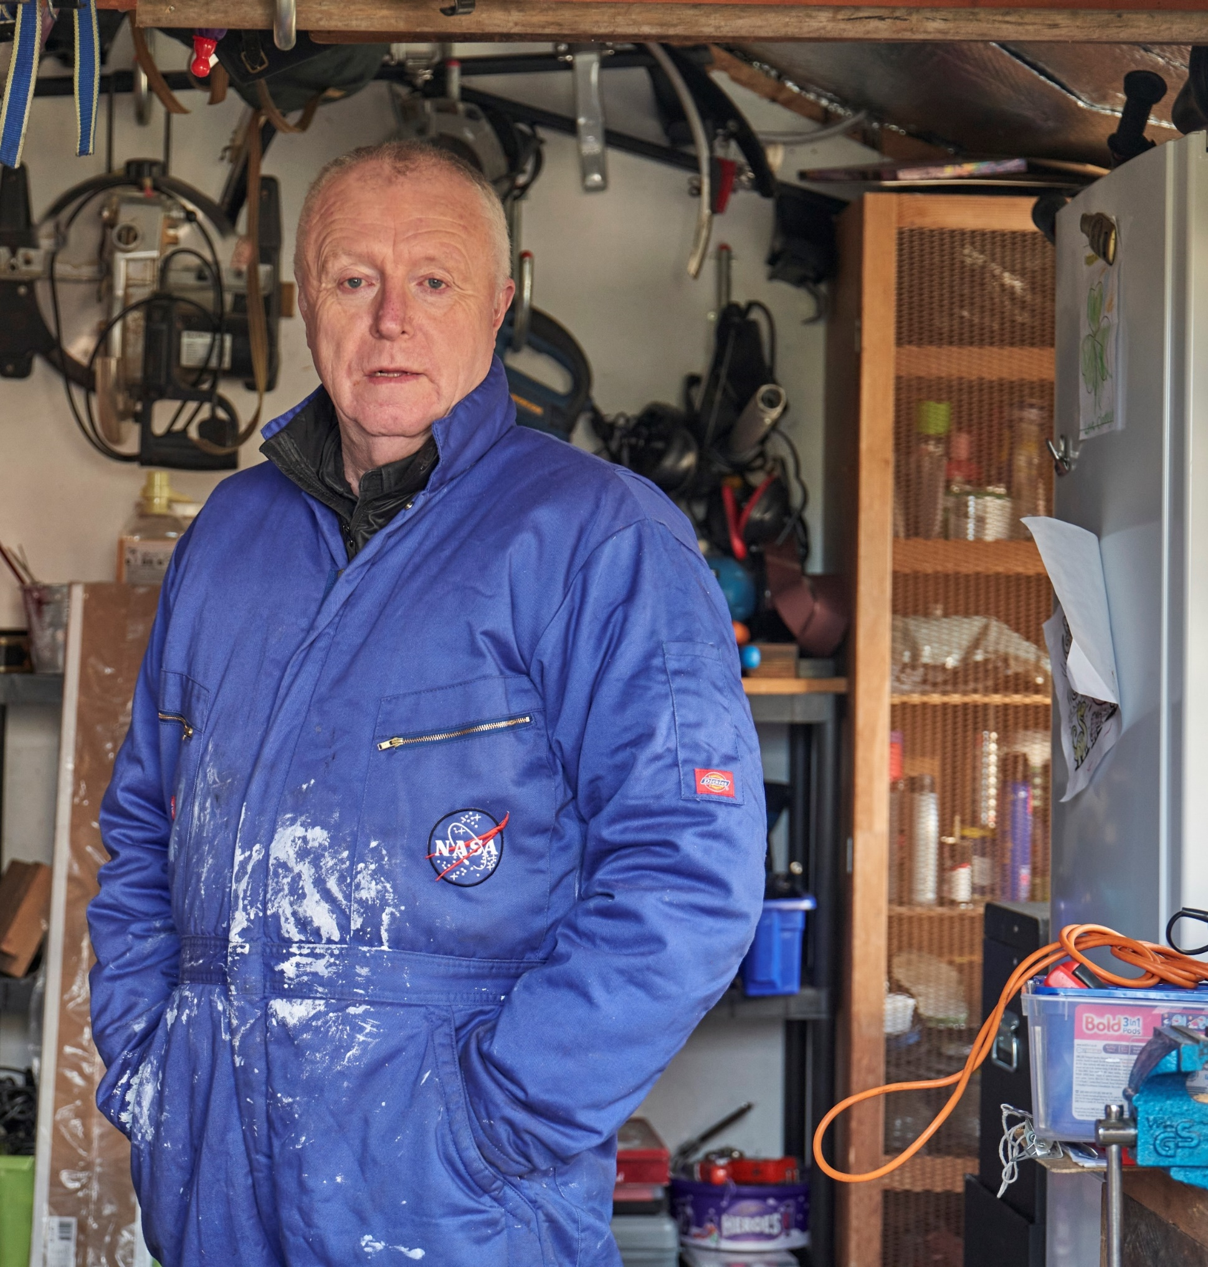
Impact on clients
Changes to practice after training more incremental than revolutionary
Hard to identify client impact directly attributable to training
Even so, around half of KWs reported:
Greater assuredness to challenge mindsets and build confidence, including clients identifying age as a barrier
Clients more engaged, more likely to progress and achieve employment outcomes
Notes:
Impact on clients
Because the changes to practice, where they occurred, were more incremental than revolutionary, it was not possible (and not really anticipated) to identify specific examples of positive outcomes for clients that were entirely attributable to the training
That said, around half of KWs were able to identify instances where they felt older clients had progressed to a greater extent than they likely would have without the KW completing the training and improving their practice…
… most commonly KWs recounted a greater level of focus on and assuredness around challenging mindsets and building confidence, including for clients specifically identifying their age as a barrier, and clients being more engaged, more likely to progress, and achieving employment outcomes as a result
And positively, impacts were not just limited to working with older clients – the greater confidence and changes to practice was benefitting KWs more generally and in their dealings with younger clients
The next two slides present some of the examples given by KWs of how the training had led to positive outcomes for clients

Slide 36
KW voices: impact on clients
“
“
I had a participant who was 59 who worked in café. She left work due to cancer, and came back to us after that, and her confidence was low, so I focused on her confidence. I used elements of the training to build that approach, and it worked well. The participant is now really confident... She’s now in another job.
I had a client who was ‘fast click’ applying on Indeed but [the job opportunities] weren’t the best. With the training I felt comfortable to show him a different way: you can do 100 garbage applications, or three really good ones… The training enabled me to support them and provide theory.”
“
After communicating better with clients, I notice they have increased engagement and are more likely to come back and be more positive with us.”

Slide 37
Equipped to support older clients
Key Workers

Slide 38
How well equipped KWs feel to support clients
KWs asked how well equipped they felt to support older clients across specific issues before and after training
All statements saw a positive movement on average score (see following slide)
Largest increases shown in supporting older clients to:
Be more confident
View their age differently
Stay motivated
Good levels of impact from baseline to follow-up across a range of areas
For all statements, some KWs reported a decrease, which may reflect greater recognition of need but a lack of support/guidance to address the need
Notes:
KWs were also asked how well equipped they felt to support older clients with a range of specific issues in both the baseline and follow-up survey
The table on the next slide shows the scores given across the statements, and the distance travelled between the two surveys. It shows:
All statements saw a positive movement on average score and at least half of KWs reported a higher score between baseline and follow-up – demonstrating good levels of impact across a range of areas
The largest effects are on supporting older clients to be more confident in themselves, to view their age differently and staying motivated – which were three of the lowest scoring initial statements in the baseline
However for all statements some KWs reported a decrease, but this might reflect better recognition of needs but lack of support/guidance to address the need

Slide 39
How well equipped KWs feel to support clients
To what extent do you agree with this statement (1=strongly disagree and 10=strongly agree)
I feel well equipped to… | Average score (baseline w/ training) | Average score (follow-up w/ training) | Difference (post - pre) | % with higher score | % with same score | % with lower score
Support older customers to be more confident in their abilities, skills and experience | 6.6 | 7.8 | 1.2 | 65% | 10% | 25%
Support older customers to view their age differently | 6.7 | 7.8 | 1.2 | 70% | 15% | 15%
Keep older customers motivated to keep applying for jobs | 6.7 | 7.8 | 1.1 | 70% | 10% | 20%
Support older customers with caring responsibilities | 6.7 | 7.5 | 0.9 | 55% | 30% | 15%
Approach employers about older customers | 6.9 | 7.7 | 0.8 | 50% | 30% | 20%
Support older customers to sell themselves to employers | 7.4 | 8.0 | 0.6 | 55% | 15% | 30%
Support older customers to see the benefits of continuing to work | 7.7 | 8.2 | 0.5 | 50% | 30% | 20%
Support older customers with physical health issues | 7.1 | 7.6 | 0.5 | 50% | 25% | 25%
Identify jobs that are appropriate for older customers | 7.3 | 7.7 | 0.4 | 55% | 20% | 25%
Support older customers to see the benefits of continuing to work | 7.8 | 8.2 | 0.4 | 55% | 20% | 25%
Support older customers with financial issues | 7.3 | 7.7 | 0.4 | 50% | 25% | 25%
Support older customers to identify their transferrable skills | 7.7 | 8.0 | 0.4 | 50% | 20% | 30%
Support older customers to take up training opportunities | 7.5 | 7.8 | 0.4 | 50% | 25% | 25%
Support older customers with mental health issues | 7.5 | 7.8 | 0.4 | 50% | 30% | 20%
Support older customers to consider different job roles | 7.6 | 7.9 | 0.3 | 50% | 15% | 35%
Support older customers to be more confident around starting a job | 7.9 | 8.1 | 0.2 | 50% | 25% | 25%

Slide 40
Suggested improvements
Key Workers

Slide 41
Suggested training improvements
60% of KWs had no improvement suggestions, indicating a good level of satisfaction
Improvements suggested by KWs included:
More face-to-face and group work
More multi-media and interactive elements (which were well received)
Advice on communicating, influencing mindset, spotting warning signs, and supporting health and skills
Follow-up resources e.g. fact sheets
What more would you have liked from the training, or how would you improve it?
Suggestions to improve training | Count | % of KWs
N/A / nothing | 12 | 60%
Face-to-face training | 3 | 15%
Clarity of content | 1 | 5%
Offer more practical solutions / more detail | 1 | 5%
Tutor led training | 1 | 5%
Provide real life examples/stories | 1 | 5%
Exposure to new learning | 1 | 5%
Look at wider job opportunities | 1 | 5%
Notes:
KWs were asked for suggestions for improvements in the focus groups, which found:
A common preference for face-to-face training and group discussions, reflecting different learning styles, and a view that discussions would help shift the focus onto real life examples and how to adapt practices
And to a lesser extent some appetite for more multi-media and interactive elements, though others did praise the training already offered in this respect
Practical solutions requested included advice around communicating, influencing mindset, spotting warning signs, and supporting specific issues (including health and skills), possibly via video demonstrations
Some appetite for follow-up resources such as a fact sheets for a reminder of learning and/or client-facing resources
A couple of KWs suggested the employer engagement team needed similar training
KWs were previously asked for suggestions in the survey:
The majority of respondents did not offer an answer or stated ‘nothing’ (60%) – the rest of the research and findings suggest this is due to a mix of good levels of satisfaction with the training and lack of engagement with the question, with the focus groups finding that KWs were more forthcoming on suggestions for improvements
Amongst the suggestions made, most common was a preference for face-to-face training, and one KW suggested tutor led training

Slide 42
KW voices: suggested improvements
“
“
I’d prefer to do face-to-face. Helps with the feel of participants, getting quicker responses, and you can see development of person. Body language can tell you a lot. Digital doesn’t work for the older participants. It creates lots of barriers before we have even started.”
More contact with employers who prefer taking on older employees. We do get a lot of jobs that are more suited for younger participants where they require lots of digital skills.”
“
On one side of the fence, we can build participants up, but we need to target employers as well and change their attitudes.”
“
Additional workshops for over 50s.”

Slide 43
Research approach
Clients

Slide 44
Evaluation: context
Ingeus conducted a baseline survey with clients aged 50+ by phone in July/Aug 2021
Follow-up in Dec/Jan 2022 to measure ‘distance travelled’
Survey targeted WHP starters between October 2020 and April 2021
Respondents on WHP long enough to have a view on support received and likely to be on WHP for the follow-up survey
Questions covered: perceptions of barriers to work; motivations and confidence; and views on the support available via WHP
Survey results show that:
Satisfaction fell between the baseline and follow-up survey on average and most of surveyed clients in the training areas
Many barriers were perceived to have worsened, perhaps as a result of greater self-awareness
133 baseline responses 39% of clients in scope 66 follow-up responses 19% of clients in scope
Notes:
The research with clients was to gather views on the programme overall and test whether there would be an observable impact on clients engagement, satisfaction, progression and outcomes. Following the analysis it is clear the survey and focus groups were unable to detect an impact as a result of the training. A few reasons are proposed for this outcome, the first due to the nature of the training and the other three methodological:The impact of the training was on KWs was positive but of small-to-moderate magnitude, limiting the likelihood of detectable impacts on client outcomes or of there being radical changes in KW practice that clients could easily identify and comment onThe numbers reached were fairly small – with 66 survey respondents split across the treatment (43 responses) and non-treatment areas (23) so comparisons between baseline/follow-up and treatment/non-treatment are very sensitive to individual clients, and there were just 7 interview/focus group participants in the treatment areas (despite concerted efforts to engage clients in the research)Respondents to surveys were on-programme for 4-9 months at the baseline and 9-14 months by the follow-up, and had not found work in that period, and are therefore more likely to have more complex barriers to work and to become less satisfied, while clients who have progressed and moved into work by the follow-up were unlikely to respond to the survey – this is reflected in the survey results, which show that between the baseline and follow-up survey satisfaction fell and many barriers worsened (this might also reflect greater self-awareness rather than barriers worsening), both on average and for a large portion of surveyed clients in the treatment areas
The interviews/focus groups with clients took place post-training only because it was deemed unlikely clients would participate twice to provide a before/after view, which meant clients were not able to give real time before/after responses – and furthermore clients would expect some changes as they progress on the programme, so attributing any changes to training would be difficult for them
Full results to the surveys are presented in the Annex – but should be reviewed with caution given the points above

Slide 45
Evaluation: challenges
Respondents to surveys were on the WHP for four to nine months at the baseline and 9-14 months by the follow-up
If they had not found work, they more likely to have more complex barriers to work and be less satisfied with WHP
If they had moved into work, they were unlikely to respond to the follow-up survey
Numbers reached were small: 66 respondents split across the training (43 responses) and non-training (23), so comparisons were sensitive to individual clients
Only seven clients participated in the interviews and focus groups in the training areas, despite efforts to engage them
Notes:
The research with clients was to gather views on the programme overall and test whether there would be an observable impact on clients engagement, satisfaction, progression and outcomes. Following the analysis it is clear the survey and focus groups were unable to detect an impact as a result of the training. A few reasons are proposed for this outcome, the first due to the nature of the training and the other three methodological:The impact of the training was on KWs was positive but of small-to-moderate magnitude, limiting the likelihood of detectable impacts on client outcomes or of there being radical changes in KW practice that clients could easily identify and comment onThe numbers reached were fairly small – with 66 survey respondents split across the treatment (43 responses) and non-treatment areas (23) so comparisons between baseline/follow-up and treatment/non-treatment are very sensitive to individual clients, and there were just 7 interview/focus group participants in the treatment areas (despite concerted efforts to engage clients in the research)Respondents to surveys were on-programme for 4-9 months at the baseline and 9-14 months by the follow-up, and had not found work in that period, and are therefore more likely to have more complex barriers to work and to become less satisfied, while clients who have progressed and moved into work by the follow-up were unlikely to respond to the survey – this is reflected in the survey results, which show that between the baseline and follow-up survey satisfaction fell and many barriers worsened (this might also reflect greater self-awareness rather than barriers worsening), both on average and for a large portion of surveyed clients in the treatment areas
The interviews/focus groups with clients took place post-training only because it was deemed unlikely clients would participate twice to provide a before/after view, which meant clients were not able to give real time before/after responses – and furthermore clients would expect some changes as they progress on the programme, so attributing any changes to training would be difficult for them
Full results to the surveys are presented in the Annex – but should be reviewed with caution given the points above

Slide 46
Research findings
Clients

Slide 47
Training impact not detected
Suggested reasons
Training impact on KWs was positive but small to moderate in scale
As a result, changes in practice were hard to detect by clients
Numbers reached were fairly small, so comparisons (baseline/follow-up, (treatment/non-treatment) were sensitive to individual client responses
Clients surveyed who had not found work by the follow up were likely to be less satisfied
Clients who found work were unlikely to respond to the follow up survey
Client focus groups were held after training but not before, with no real-time ‘before and after’ responses
Notes:
The research with clients was to gather views on the programme overall and test whether there would be an observable impact on clients engagement, satisfaction, progression and outcomes. Following the analysis it is clear the survey and focus groups were unable to detect an impact as a result of the training. A few reasons are proposed for this outcome, the first due to the nature of the training and the other three methodological:
The impact of the training was on KWs was positive but of small-to-moderate magnitude, limiting the likelihood of detectable impacts on client outcomes or of there being radical changes in KW practice that clients could easily identify and comment on
The numbers reached were fairly small – with 66 survey respondents split across the treatment (43 responses) and non- treatment areas (23) so comparisons between baseline/follow-up and treatment/non-treatment are very sensitive to individual clients, and there were just 7 interview/focus group participants in the treatment areas (despite concerted efforts to engage clients in the research)
Respondents to surveys were on-programme for 4-9 months at the baseline and 9-14 months by the follow-up, and had not found work in that period, and are therefore more likely to have more complex barriers to work and to become less satisfied, while clients who have progressed and moved into work by the follow-up were unlikely to respond to the survey
– this is reflected in the survey results, which show that between the baseline and follow-up survey satisfaction fell and many barriers worsened (this might also reflect greater self-awareness rather than barriers worsening), both on average and for a large portion of surveyed clients in the treatment areas
The interviews/focus groups with clients took place post-training only because it was deemed unlikely clients would participate twice to provide a before/after view, which meant clients were not able to give real time before/after responses – and furthermore clients would expect some changes as they progress on the programme, so attributing any changes to training would be difficult for them
Full results to the surveys are presented in the Annex – but should be reviewed with caution given the points above

Slide 48
Barriers to employability faced by 50+ cohort
Good match of issues identified by clients and issues covered in training
Health was the top barrier identified by clients, who cited:
Bad back, lost use of an arm, repetitive strain injury
Stroke, arthritis, cataract
Depression, trauma and anxiety
Age and age discrimination were cited by one in three client respondents
What are your top three barriers to work?
Reasons given | All clients
 | Count | %
Health | 90 | 75
Age | 42 | 35
Limited skills/experience, qualifications or long-term unemployed | 22 | 18
Location | 19 | 16
Nature of available jobs | 12 | 10
Confidence | 9 | 8
IT skills/access | 6 | 5
Other | 5 | 4
COVID | 4 | 3
Job search: access, skills, CV | 4 | 3
Caring responsibilities | 4 | 2
Motivation | 1 | 1
Notes:
Nature of the issues that 50+ clients face
While an impact was not observable in the client survey and interviews/focus groups, they did help illustrate the nature of the issues that older clients on WHP face – so the remainder of this section provides more detail around this
A positive finding is that the issues identified by clients reflected the types of issues covered in the training – with no barriers identified by clients that pointed to a gap in the training materials or WHP offer
Note that the survey results combine the treatment and non-treatment areas rather than separate them out

Slide 49
Personal barriers to work
Clients rated six barriers to work
Personal circumstances and health were the most significant barriers
Age was relatively highly rated as a barrier
Caring responsibilities were the least significant barrier
How much do the following make it harder for you to secure work (1 = very difficult, 6 = no problem)
Statement | Average score - all clients
Caring responsibilities | 5.3
Financial situation | 3.8
My Skills | 3.7
How customer views their age | 3.3
My Health | 2.8
My Personal Circumstances | 2.8
Notes:
Clients were asked to rate six specific barriers to work between 1 and 6. Three of these (‘My Skills’, ‘My Personal Circumstances’ and ‘My Health’) were chosen to align with existing WHP monitoring data. The other options are new. It shows:
Personal circumstances and health were the most significant barriers
Age was relatively highly rated as a barrier
Caring responsibilities were the least significant barrier

Slide 50
Client voices: what barriers to work do you face?
“
“
Age – they may choose a younger person.”
I was employed for many years so skills set, as only I know hospitality employment.”
“
“
Area as needs to be in five mile radius due to health.”
On the employer’s side, they are more likely to employ younger people so they can get trained up.”
“
Anxiety due being out of work for a while.”
“
Skills need to be updated.”
“
Possibly overqualified for some jobs.”
“
Skills need to be updated.”

Slide 51
Client voices: what barriers to work do you face?
“
“
I do have lots of experience, but employers I am speaking to seem to lose interest and conversations stop. I think that I question whether age is a barrier and I think I could add a lot to their sector due to my employment history.”
The type of work I have done, like hospitality, your appearance and personality is very important. And I am finding ageing as a process is really hard. I don’t fit in the way I used to and I’m not as valuable. I am lost for what I am going to do.”
“
I don’t think age is a barrier in my sector. There are jobs for me like HGV driving and logistics. I could get a job in a company I have worked with before. They don’t have an age limit, I just need a CSCS card.”

Slide 52
Switching job and reskilling
Clients rated their willingness to change jobs or reskill for new opportunities
The 50+ cohort was:
Reasonably open to trying new jobs
Open to reskilling
For some clients, responses reflected:
Feelings that they were no longer desirable or competitive in their previous industries
A need to switch job due to health issues that made them ill suited to previous jobs
How willing are you to …? (6 = fully, 1 = not at all)
Consider a job different from what you did before
Train in new skills to secure work
4.5
4.8
Notes:
The baseline survey found 50+ clients were more open to reskilling, and mostly pretty open to jobs they had not worked in before
How willing are you to … ? (6=fully and 1=not at all)
The fieldwork found that for some clients this was driven by a feeling that they were no longer deemed desirable or competitive in their previous industry, or by a need to switch job due to health issues that were poorly suited to their previous
occupation

Slide 53
Confidence
Clients rated their confidence in searching for and securing a job
The 50+ cohort was:
Reasonably confident about securing a job
More confident about being successful in work
However, :
How confident are you about…? (6 = fully, 1 = not at all)
How confident are you to … ? (6 = fully, 1 = not at all)
Your success in a job if you took one today
Your level of job search skills
Your ability to sell yourself to an employer
Your ability to find and obtain work
4.6
Consider a job different from what you did before
Train in new skills to secure work
4.5
4.8
4.3
4.3
3.7
Notes:
The baseline survey found 50+ clients were more open to reskilling, and mostly pretty open to jobs they had not worked in before
How willing are you to … ? (6=fully and 1=not at all)
The fieldwork found that for some clients this was driven by a feeling that they were no longer deemed desirable or competitive in their previous industry, or by a need to switch job due to health issues that were poorly suited to their previous
occupation

Slide 54
Findings from WHP monitoring data analysis

Slide 55
About the WHP monitoring data
WHP collects data on clients, including:
Extensive data on characteristics and barriers to work
Support provided – including referrals to external support
Intermediate ‘soft’ outcomes
‘Hard’ employment outcomes, covering:
Job starts
Earnings thresholds met within 21 months of starting WHP (15 months of support + six months) based on HMRC data.
Notes:
WHP collects monitoring data on clients, including on:
Extensive data on characteristics and barriers to work – captured at an initial assessment
The support provided – including referrals to external support
Outcomes achieved – including intermediate ‘soft’ outcomes and ‘hard’ employment outcomes, covering job starts and earnings thresholds met within 21 months of starting the programme (15 months of support + 6 months) based on HMRC data

Slide 56
Challenges for the monitoring data analysis
Data collection was exploratory and not specifically to evaluate training
Clients were at different WHP stages: early, mid-stage, near completion, so the impact of training in KW practice differed
Limited numbers (328 starters in treatment areas, 174 n non-treatment areas)
Many were recent starters, with little time to deliver support and achieve work outcomes
Local labour markets and the effect of pandemic influenced outcomes
Client group characteristics, barriers and level of need differed by area
Shifts between remote, face-to-face and hybrid support
Adoption and roll-out of a new referrals system to external support
Extra time would give a more robust analysis of larger cohorts, but the risk of staff changes (esp. untrained joiners) may temper impact
Notes:
Like the client survey, the analysis of monitoring data was an exploratory piece of research to test whether any impact could be discerned within the data.
But unlike the client survey, the monitoring data was not collected specifically to evaluate the training, and so does not allow for a clear before/after comparison which made the analysis challenging, especially in combination with out limitations, namely:
While the KW training was an intervention at a specific point in time, the programme clients who may have been impacted by changes in practice will have been at different stages of their journey – some will be close to completing the programme, some will be mid-way through, some will have joined recently, and others would have joined post-training
The entirely post-training group would be the ideal group to monitor to test any impact of the training, however:
Numbers are limited – since the start of Aug-21 there have been 328 starters in the treatment area and 174 in the non-treatment area (Ingeus only as comparing against TGC risks differences due to different practices/processes)
And of those, many were very recent starters, providing little time for support to be delivered and to achieve employment outcomes
Therefore the most appropriate analysis is of monthly data and cohorts, but this is prone to wide variation given the small numbers in individual months, and the narrow time window being considered reduces the certainty that any trends are not just short-term variation based on small numbers
Further complicating the analysis are:
The influence of local labour markets and the pandemic on outcomes – the programme has not been operating in a stable environment, and local labour markets differ between the treatment and non-treatment areas
The areas also differ in the nature of their client groups, with different characteristics, barriers and level of need between them, which are also not stable
Changes in the support offer and provider practices/processes – including shifts between remote, face to face and hybrid support, plus adoption and roll-out of a new system for referrals to external support
The result of these challenges is that additional time would allow for more robust analysis due to larger cohorts, cleaner treatment/control groups, a sufficient level of outcomes to be achieved and recorded – although there is greater risk of staff changes (specifically untrained staff joining) in the treatment area which would temper any impact in the data (even assuming an impact can be detected)

Slide 57
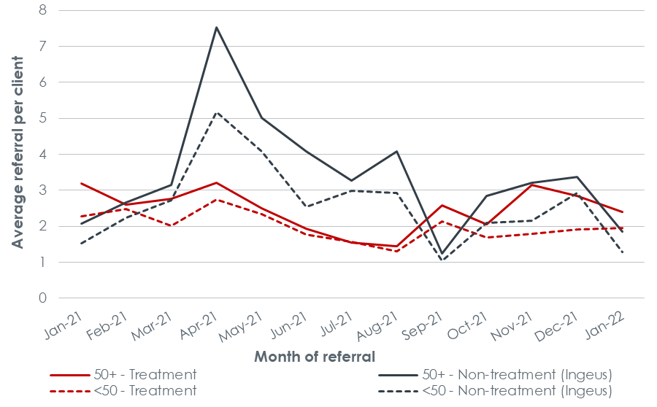
Referrals to external support
During the study period, we saw a general increase in referrals for 50+ clients in both the treatment and non-treatment areas.
The two areas are now more closely aligned than before the training, but is more due to fewer in referrals in the non-treatment areas, where a new referral system is bedding down.
Referrals to external support per WHP client
Notes:
The chart shows the average number of referrals to external support per on- programme client (i.e. clients who have not left, and are not in work) for the treatment and non-treatment areas, for the 50+ and under 50 cohorts
It shows a general increase in referrals for 50+ clients in both the treatment and non-treatment areas so the two areas now appear more closely aligned than prior to the training, but this is more due to a decline in referrals in the non- treatment areas – likely reflecting the newness of the referral system and its use bedding down

Slide 58
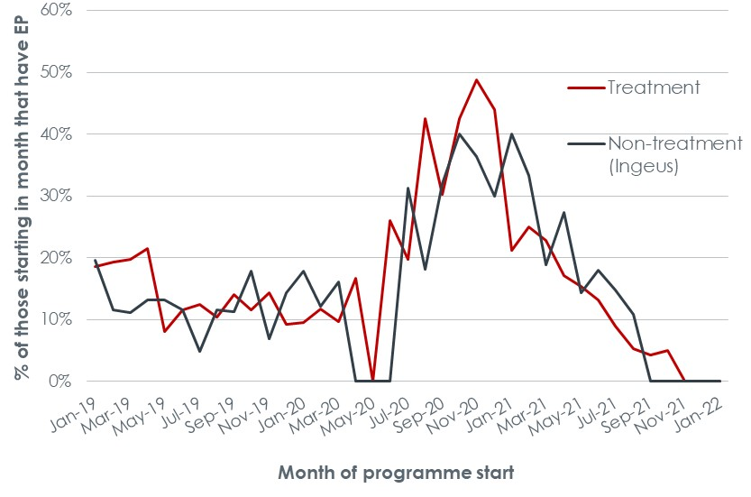
Earnings Present (EP) during and post-training
From July 2020 onwards, 50+ clients recording earnings with HMRC within 21 months of WHP start rose considerably due to:
More work-ready clients
Changes in labour markets
50+ cohort EP outcomes were better in all areas vs non-treatment areas
Post-training outcomes (after July 2021) suggest improvement
Clients with ‘Earnings Present’ (EP) notifications
Notes:
Employment outcomes
This chart shows 50+ clients with an ‘Earnings Present’ (EP) notification – meaning the programme received a notification from HMRC that the client had earned some wages within 21 months of programme start – as a proportion of those who started the programme in each month
It shows how programme performance has improved considerably for those starting after the pandemic (the WHP evaluation’s 2021 Annual Report attributed this to a mixture of more work ready clients and changes to the labour market)
The most useful part of the chart to consider is Jul-21 onwards, as their time on the programme is entirely post- training – the data does suggest a possible improvement for recent programme starters but this is based on very small numbers, an issue compounded by the time it takes to secure employment and for an EP notification to be recorded, with no EPs yet recorded for Nov-21 onwards
Therefore the table focuses on the EP achievement rate for starters in July to October, and actually shows the 50+ cohort performing better in all areas and a bigger gap for the treatment vs non-treatment Ingeus areas – noting it is still early

Slide 59
Earnings Present (EP) post-training
EP data for client on WHP post- training suggest a possible improvement for recent starters, but:
Analysis is of small numbers
Lag in notifications from HMRC means no EPs have yet been recorded for Nov-21 onwards
EP rate from July-Oct 2021 shows:
50+ performing better in all areas
Increased gap for treatment vs non-treatment areas
Clients with EP notifications
Jul-Oct 2021 starters with EP | 50+ | <50 | Difference
Treatment | 5.9% | 5.6% | 0.3%
Non-treatment (Ingeus) | 6.6% | 6.5% | 0.1%
Non-treatment (TGC) | 5.3% | 2.9% | 2.4%
Notes:
Employment outcomes
This chart shows 50+ clients with an ‘Earnings Present’ (EP) notification – meaning the programme received a notification from HMRC that the client had earned some wages within 21 months of programme start – as a proportion of those who started the programme in each month
It shows how programme performance has improved considerably for those starting after the pandemic (the WHP evaluation’s 2021 Annual Report attributed this to a mixture of more work ready clients and changes to the labour market)
The most useful part of the chart to consider is Jul-21 onwards, as their time on the programme is entirely post- training – the data does suggest a possible improvement for recent programme starters but this is based on very small numbers, an issue compounded by the time it takes to secure employment and for an EP notification to be recorded, with no EPs yet recorded for Nov-21 onwards
Therefore the table focuses on the EP achievement rate for starters in July to October, and actually shows the 50+ cohort performing better in all areas and a bigger gap for the treatment vs non-treatment Ingeus areas – noting it is still early

Slide 60
Conclusions and recommendations
Training was well received
Postive influence on KW behaviour
Conclusive impact on clients harder to discern
Training could be augmented

Slide 61
Reaction
Findings
Training format and content were generally well received
Reflections
A significant number of KWs favour a face-to-face element and group discussions as part of the training, reflecting different learning styles

Slide 62
Learning
Findings
Training confirmed existing knowledge and practice for man
Some recognised new learning around understanding age as a barrier to work and how to support older clients
Issues covered were in line with the barriers to work identified by clients in the fieldwork
Reflections
Even if learning was not ‘new’, instilling confidence and reminding KWs what is important (e.g. personalised approaches) had value
Opportunities to discuss training content together enhanced KWs’ learning and could be built into future programmes
Follow-up resources may reinforce learning

Slide 63
Behaviour
Findings
Around half of the KWs saw a need to change their practice, particularly les experienced and younger KWs who felt less equipped to support the 50+ cohort
Changes related to:
Greater awareness and understanding of older clients
More focus on building confidence and identifying transferable skills
Reflections
Provide training during induction to support less experienced KWs
Experienced KWs valued a ‘refresher’
Explicit awareness of what good practice is will benefit older clients (and others on the WHP as well)

Slide 64
Impact
Findings
Positive KW feedback
Positive change in client outcomes harder to detect
Tentative positive signs, but the analysis is constrained by:
Low client numbers
Timescales
Small nature of changes in support
Reflections
Impact may become more apparent over time, if the analysis could focus on a group who started after the training was delivered
Scale of impact may be too small to be discernible
KWs suggested the training for the Employer Services Team to inform their practices when dealing with employers

